Slide 1

Advanced System Navigation
Let’s level up!
Notes:
Main Title Page

Slide 2
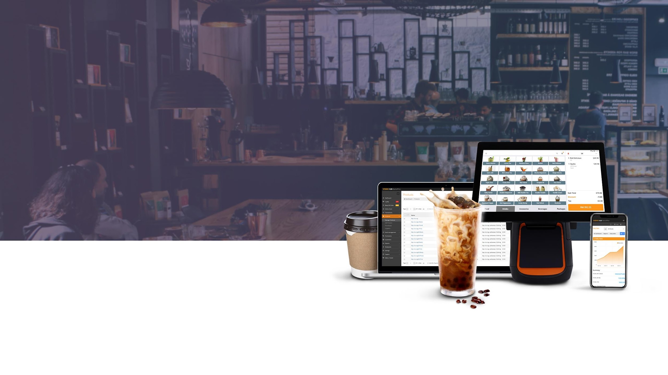

Advanced System

Slide 3
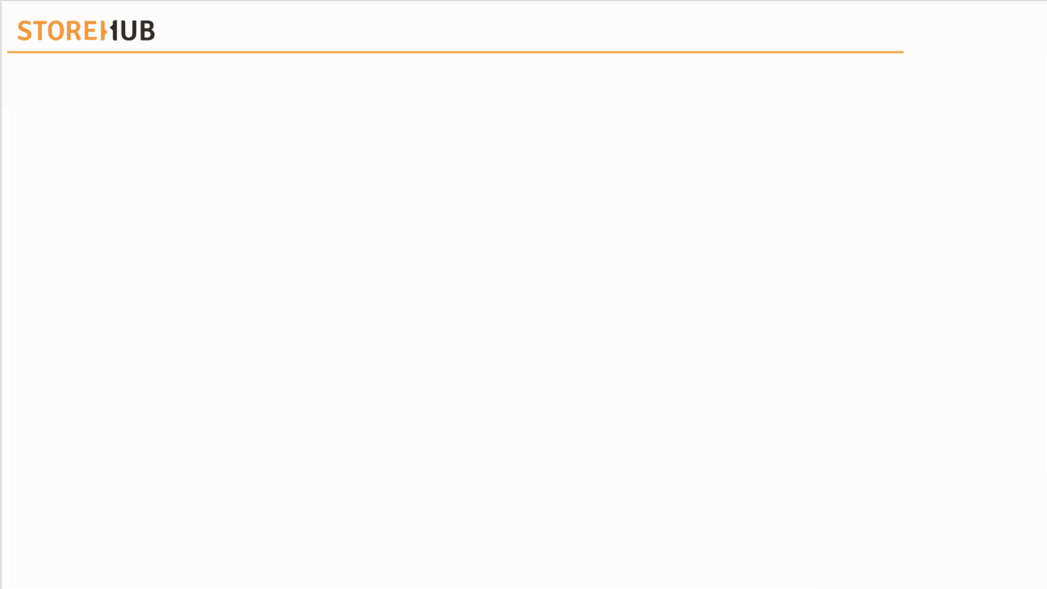

| Advanced System
Overview
Reports
Product Inventory (Composite)
01
02
Not applicable for Onboarding Coordinator
Manage Product (CSV)
03
04
Pricebook
Promotion
05

Slide 4
Reports
Not applicable for Onboarding Coordinator, skip to next topic

Slide 5
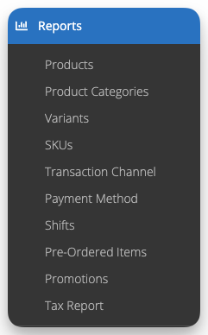
| Reports
Reports (Sales)
Reports
Reports are instrumental in understanding business performance, optimizing inventory, setting goals & improving overall operations.
Different types of Reports are available in the BackOffice. Those reports data are categorized based on different aspects, allowing you to analyze sales data in various ways.

Slide 6
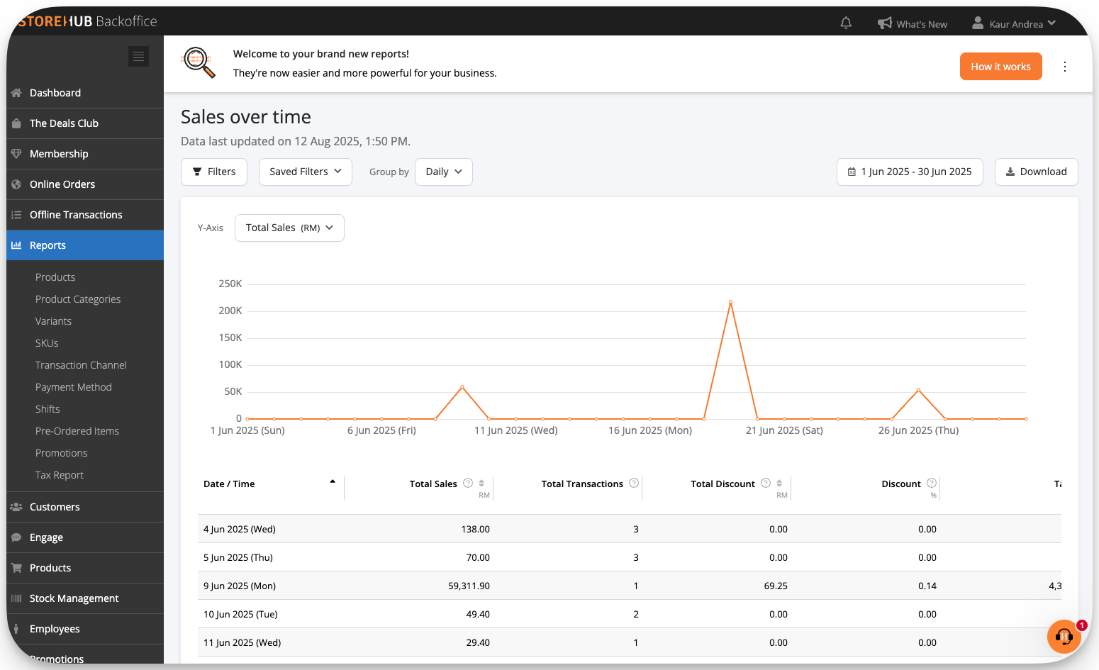
| Reports
Filters
Save your filters so that in future you may easily re-apply those filters that you may constantly use.
To customise dates by period or custom dates to view report history
Option to view via your Store Name or Time Variable (i.e. Daily, Weekly, Monthly..)
Filter via Transaction Channel, Store Name, Product Attributes and Customer Attributes.
Product Attributes will only be available on Sales by Products/Products Categories/Variants/SKUs
Options to download report to Excel or CSV
General Filters used in the highlighted report section.

Slide 7
| Reports
Promotions
Promotions Report
Promotion report helps business to understand frequency of promotions applied, measure the effectiveness of promotions & ease the process of calculating cost of promotions.

Slide 8
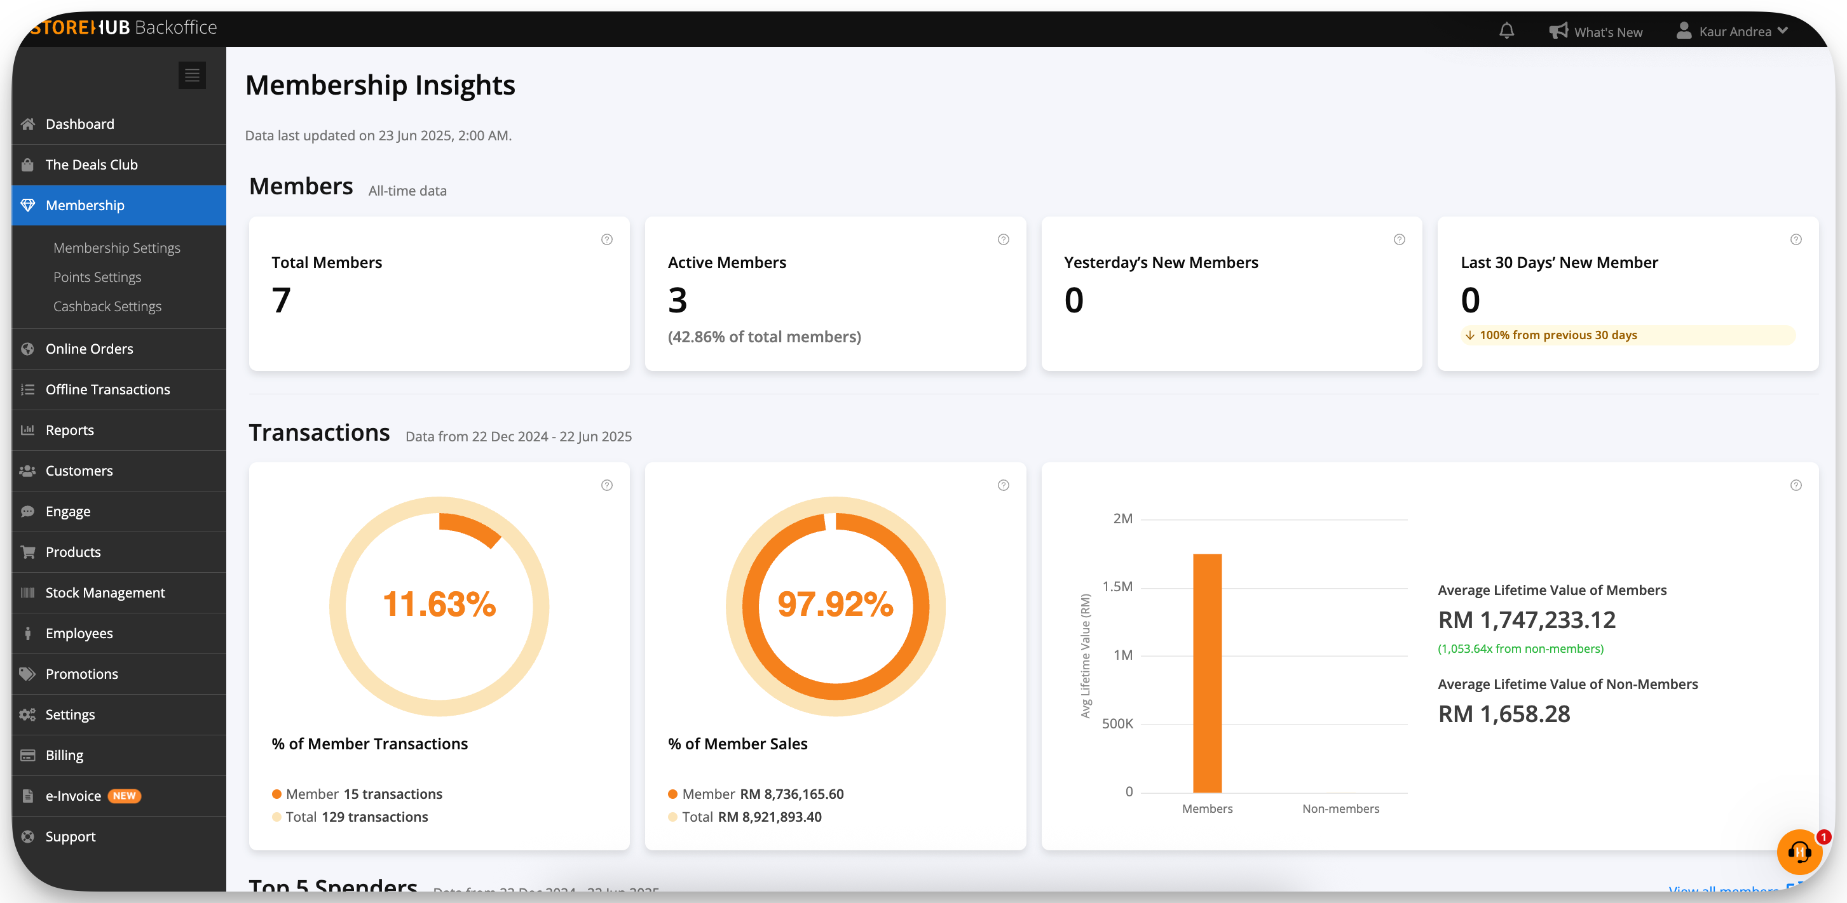
| Reports
Membership
Membership Report
The Membership Report helps merchants analyze member activity by providing key insights into spending patterns, transaction history, sales trends, and top spenders.

Slide 9
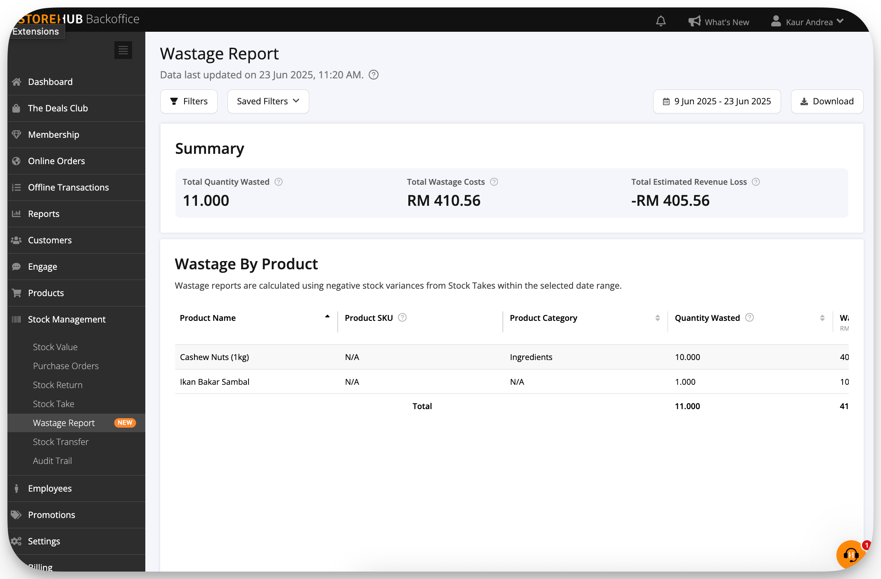
| Reports
Wastage
Wastage Report
Helps merchants evaluate inventory loss by detailing the total wastage cost, providing a product-by-product breakdown, and calculating the resulting loss of revenue.
This report automatically populates after a Stock Take is completed. Any discrepancies discovered between your expected and actual product quantities will be logged here.

Slide 10
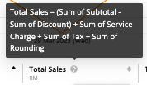
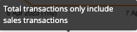
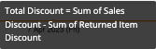
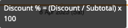
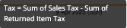
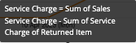
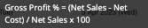
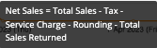
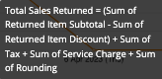
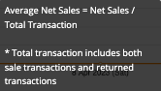
| Reports
Formula / Description
Hover over the “?” button to check the formula/description
IP = Internet Protocol

Slide 11





| Report Troubleshooting
Overview
1
2
3
Sales Report: Overtime vs. Shift Report
Shift Report vs. Payment Method
All Transaction vs. Shift Report
4
5
Variant Report vs.
Product Report
Sales Report: Overtime vs. Product Report

Slide 12
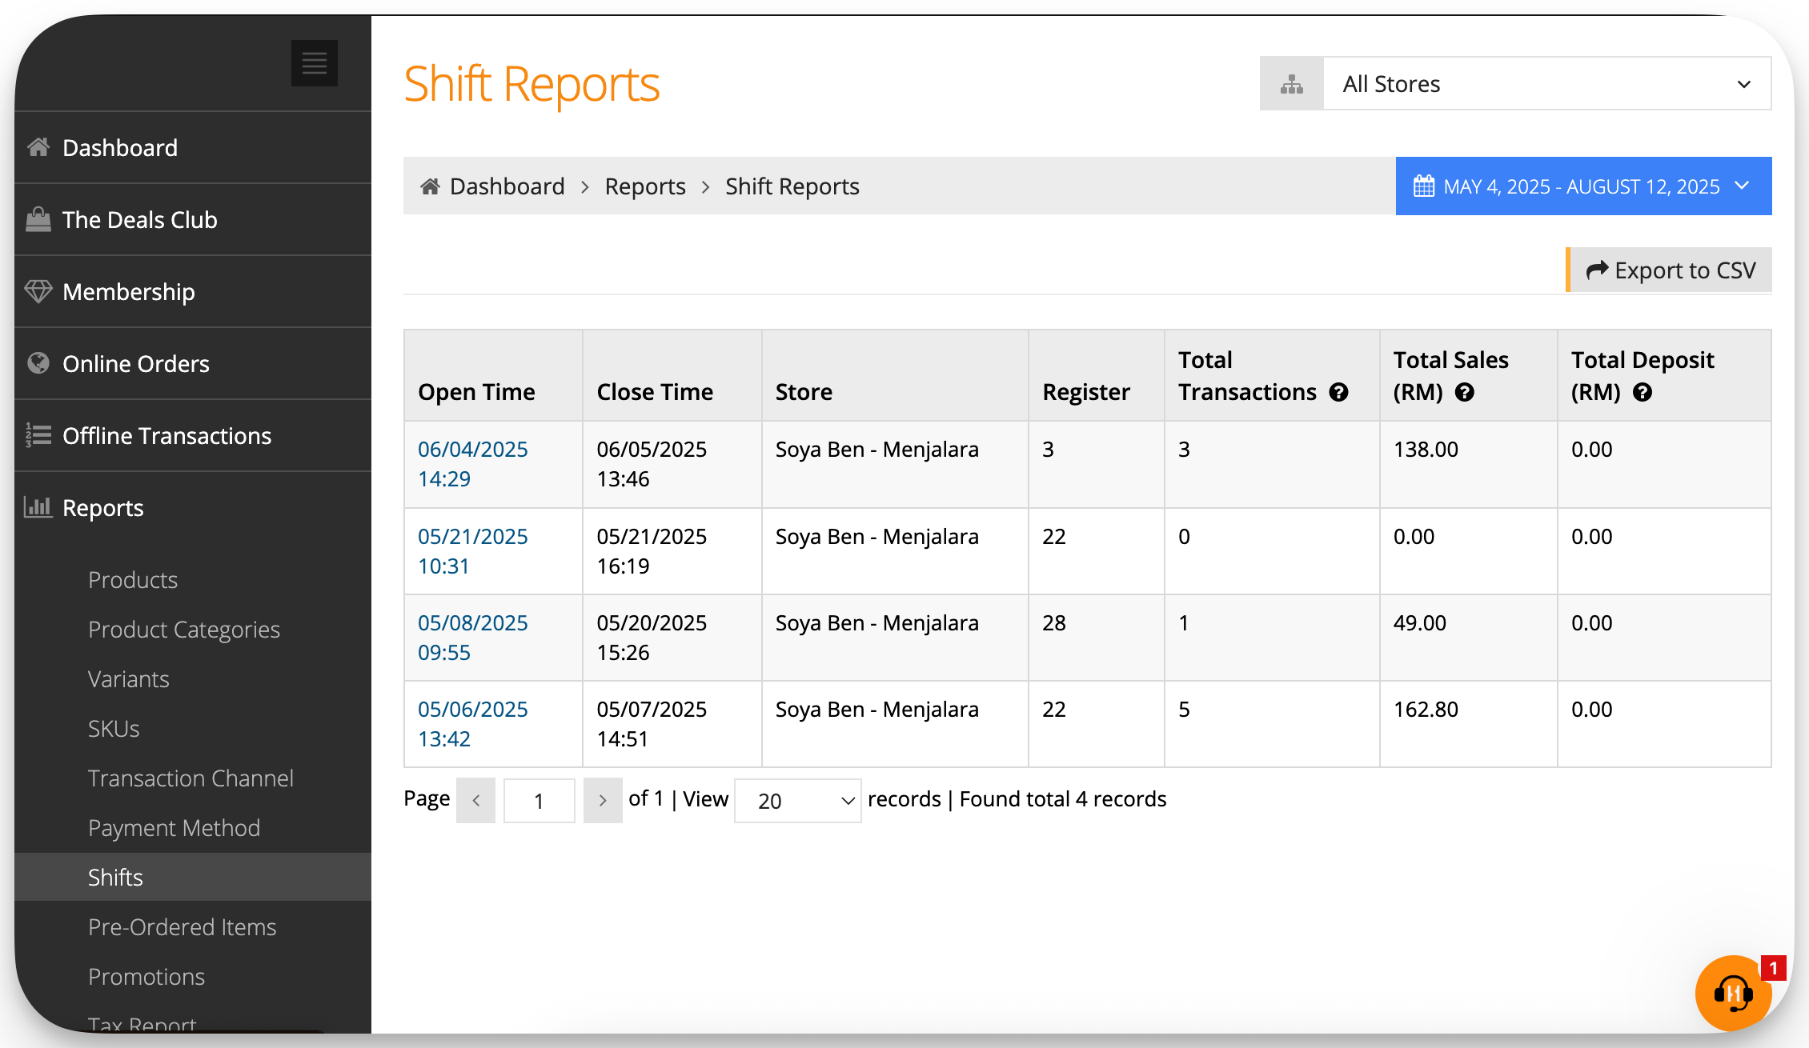
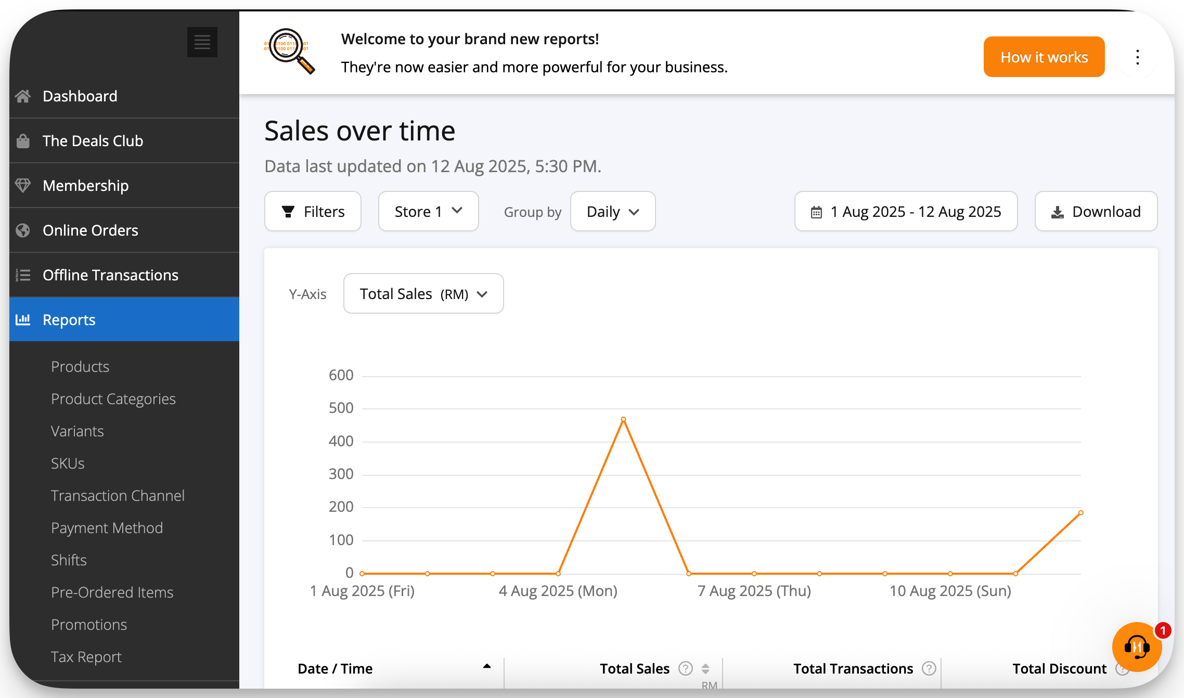
| Report Troubleshooting
What is..
Shift Report ?
Over Time Report?
A Shift Report is a summary of sales, transactions, and activities completed during an employee’s shift.
Does not consist of Online Orders. Only Offline and QR Order and Pay - Pay at counter sales are recorded.
The Sales Over Time report shows you Offline and Online transaction, most accurate sales and its based on the closing time of operations.
It operates on a 24-hour cycle to generate a single day's report.

Slide 13
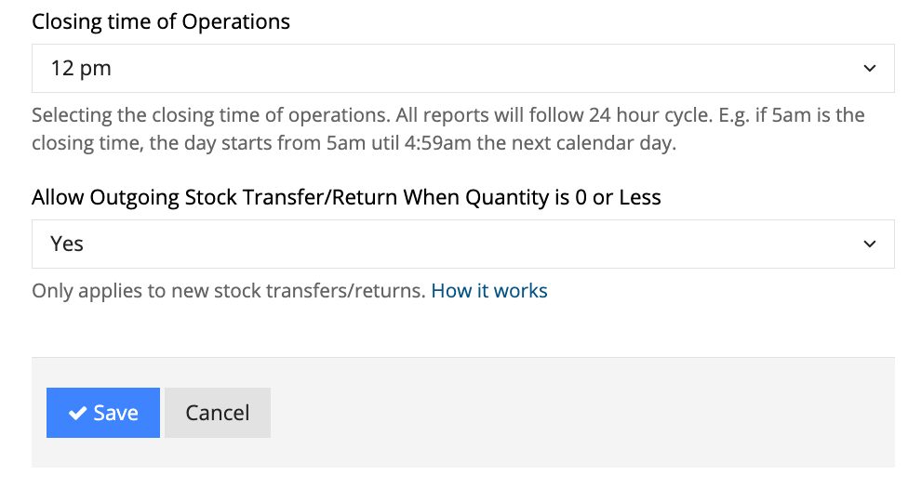
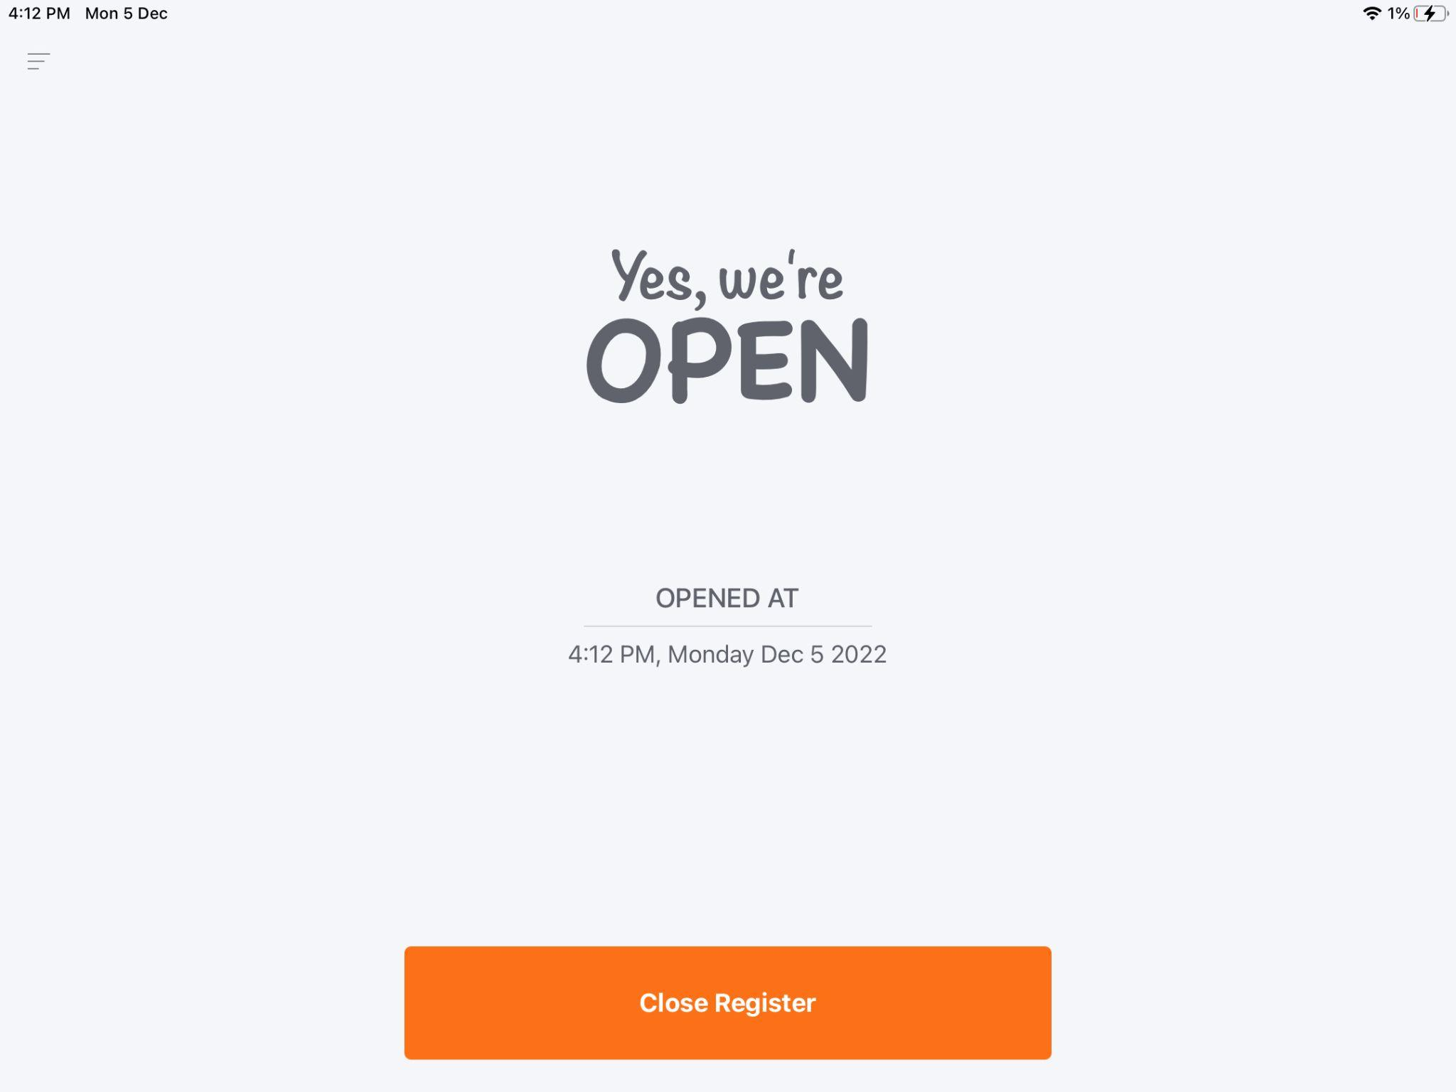
| 1. Sales Report: Overtime vs. Shift Report
Why Total Sales on Sales Report and Shift Report Don’t Match?
Understanding the Issue:
The Sales Over Time Report is based on the closing time of operations configured in the BackOffice settings.
The Shift Report, however, is generated when the register is manually closed in the POS app, which can happen at any time.
Example Scenario: If the closing time in BackOffice is set to 12 AM, but the register is closed at 2 AM, sales data from 12 AM to 2 AM will not be included in the Sales Over Time Report for the same day.
Solution: Ensure to close the Shift before Closing Operations time.
BackOffice
BackOffice > Settings > Account
StoreHub POS Apps
StoreHub POS Apps > Menu Button > Close Shift

Slide 14


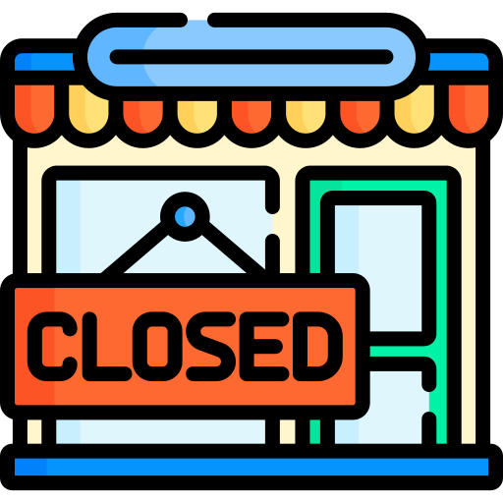

| 1. Sales Report: Overtime vs. Shift Report
Shift Report
20th Sep
6 AM
8 AM
6 PM
20th Sep Sales Over Time Report
21st Sep
6 AM
7:59 AM
6 PM
Shift Report

Slide 15
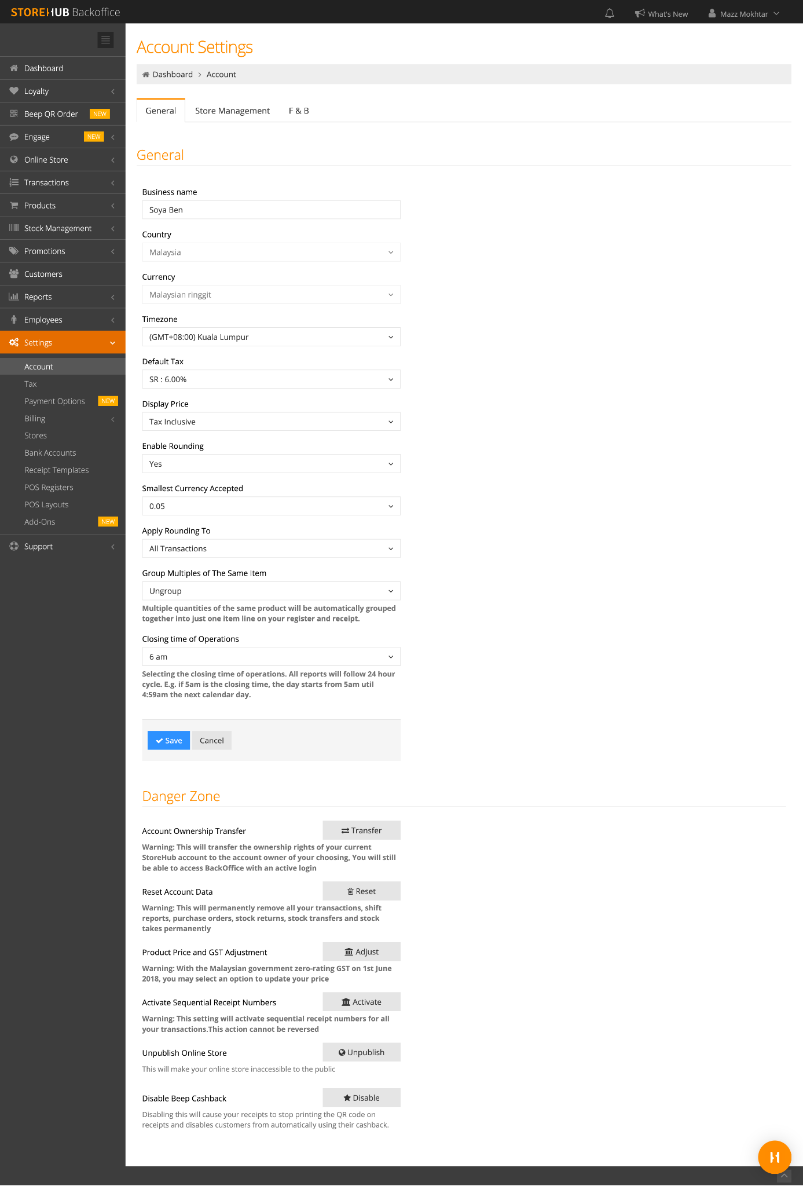
| 2. Shift Report vs. Payment Method Report
Reason : Closing Time of Operation & Close Shift Time are Different
Issue: Total Transactions & Total Sales on Shift Report is not tally with Payment Method Report
BackOffice
StoreHub POS Apps
BackOffice > Settings > Account
Merchant have to selects the closing time of operations on BackOffice & all reports will follow 24 hour cycle E.g. if 5am is the closing time, the day starts from 5am util 4:59am the next calendar day
Shift report generated from the POS should follow the report cycle.
StoreHub POS Apps > Menu Button > Close Shift

Slide 16
| 3. All Transaction vs. Shift Report
Reason : Closing Time of Operation & Close Shift Time are Different
Issue: Total Transactions & Total Sales on All Transaction is not tally with Shift Report
BackOffice
StoreHub POS Apps
BackOffice > Settings > Account
Merchant have to selects the closing time of operations on BackOffice & all reports will follow 24 hour cycle E.g. if 5am is the closing time, the day starts from 5am util 4:59am the next calendar day
Shift report generated from the POS should follow the report cycle.
StoreHub POS Apps > Menu Button > Close Shift

Slide 17
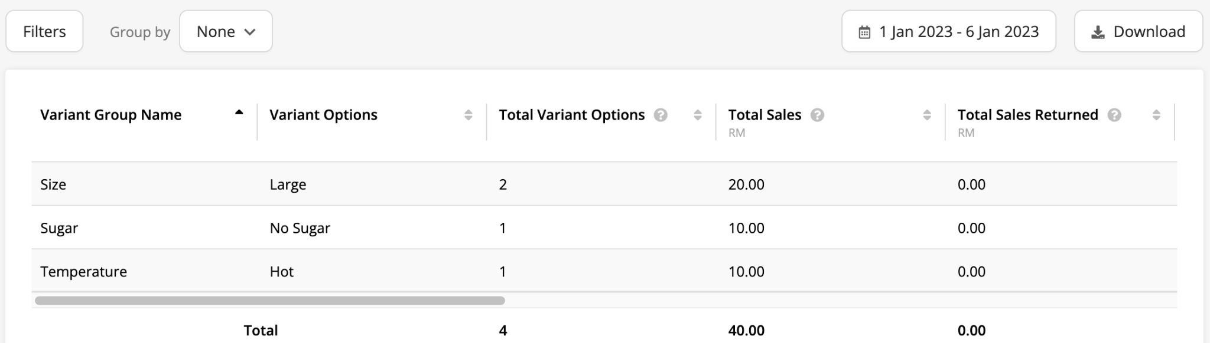
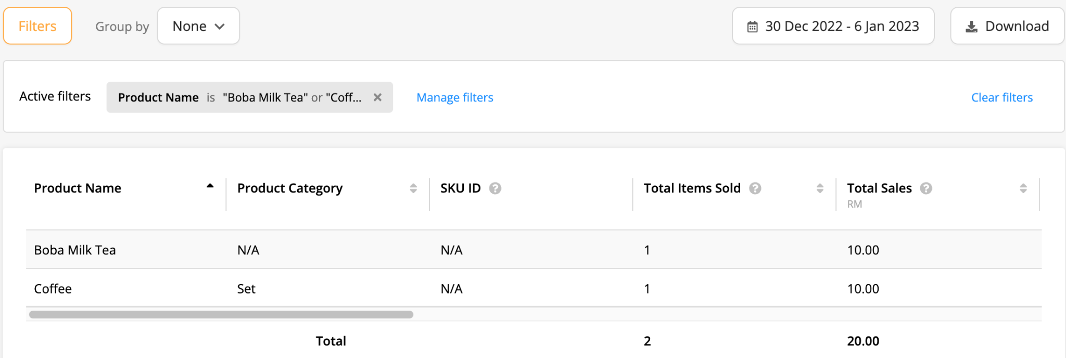
| 4. Variant Report vs. Product Report
Reason: Total Times of Variant
Variant Report
Issues
Total Sales in Variant Report: Over Time is not tally with Product Report
Reasons
Variant report records variants while Product report records the actual product that is sold
Product Report

Slide 18

| 4. Variant Report vs. Product Report
Example
How does sales amount reflect in report when 1 Boba Milk Tea is sold ?
Product Report
Boba Milk Tea - RM 10
Variant Report
Size - RM 10
Sugar Level - RM 10
Boba Milk Tea
Price: RM 10
Modifiers
Size
Sugar Level

Slide 19

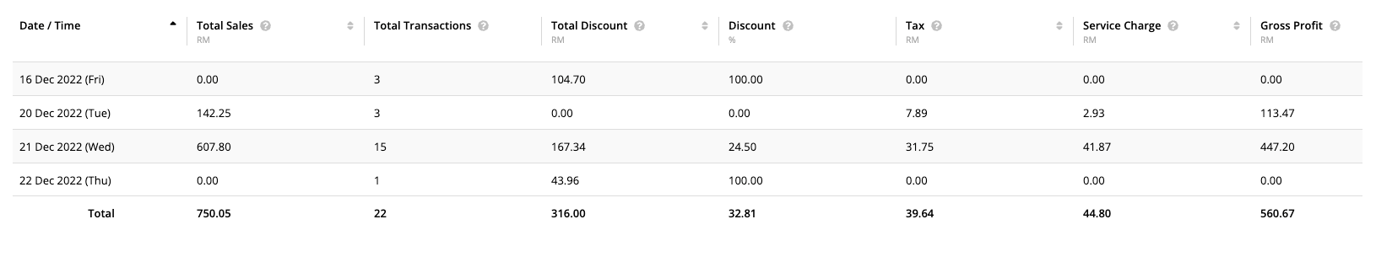

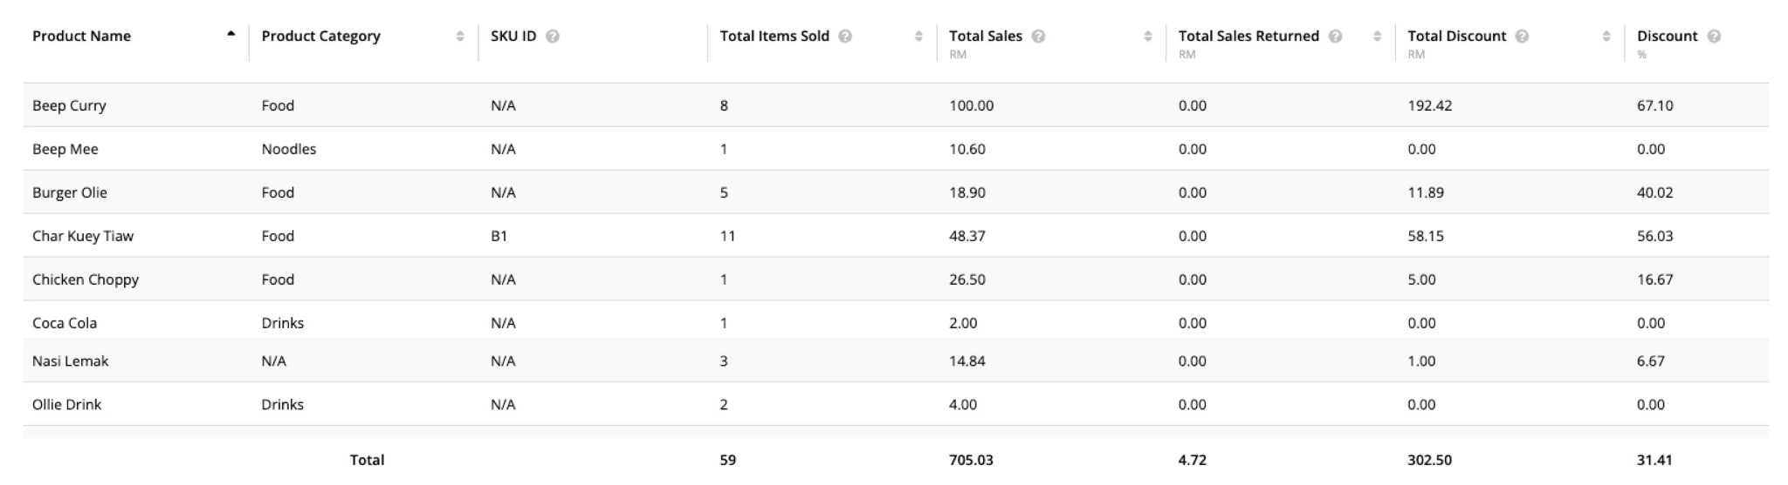
| 5. Sales Report: Overtime vs. Product Report
Reason: Itemised Sales Figure
Issue: Total Sales on Sales Report: Overtime is not tally with Product Report
Sales Report: Overtime
Total Sales: MYR 750.05
Product Report
Total Sales: MYR 705.03

Slide 20

| 5. Sales Report: Overtime vs. Product Report
Reason: Itemised Sales Figure (cont.)
Sales Report: Overtime Formula
Total Sales:
(Sum of Subtotal - Sum of Discount) + Sum of Service Charge + Sum of Tax + Sum of Rounding
Product Report Formula
Total Sales:
(Sum of Item Subtotal - Sum of Item Discount) + (Sum of Item Tax - Sum of Returned Item Tax)
Following are the items that are not inclusive in Product Report:
Rounding
Service Charge
Service Tax
Full bill discount

Slide 21
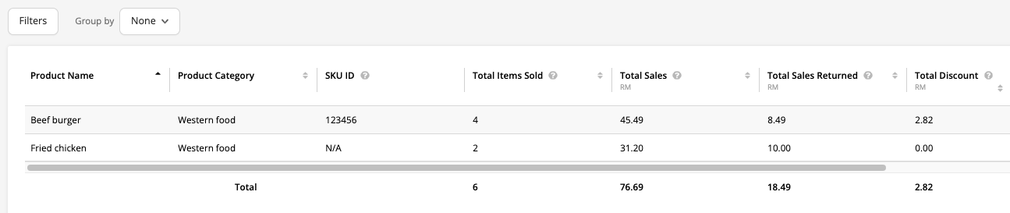
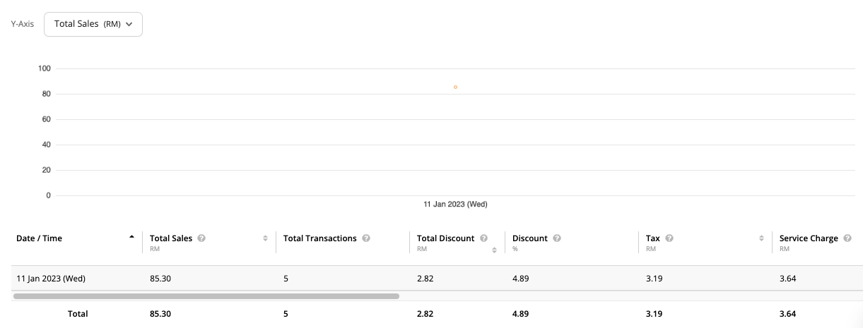
| 5. Sales Report: Overtime vs. Product Report
Reason: Itemised Sales Figure (cont.)
Product Report
Overtime Report
Total does not tally as product report only included everything in itemised level

Slide 22
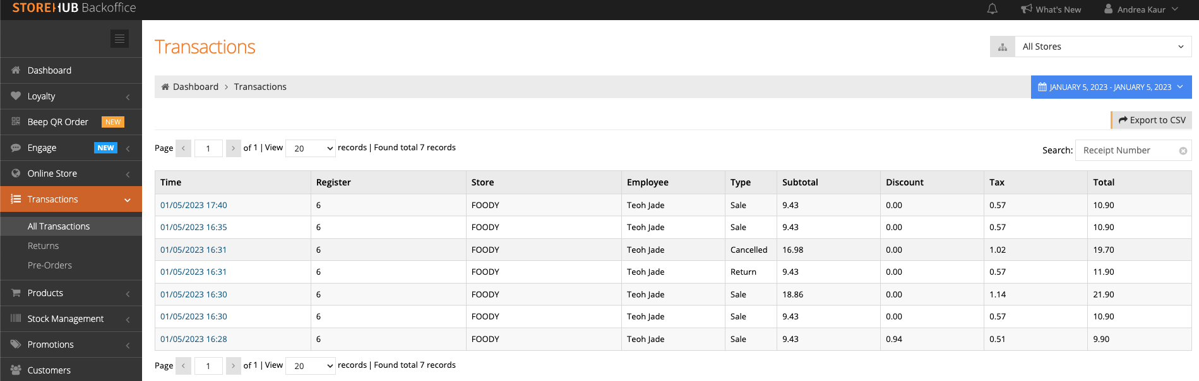
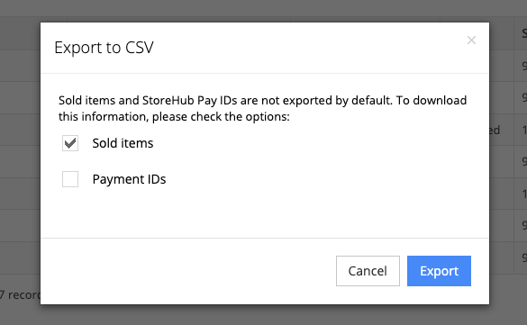
| 5. Sales Report: Overtime vs. Product Report
Reason: Itemised Sales Figure (cont.)
Under Transactions > All Transaction, filter out the date and click on “Export to CSV”, then tick on “Sold items”

Slide 23
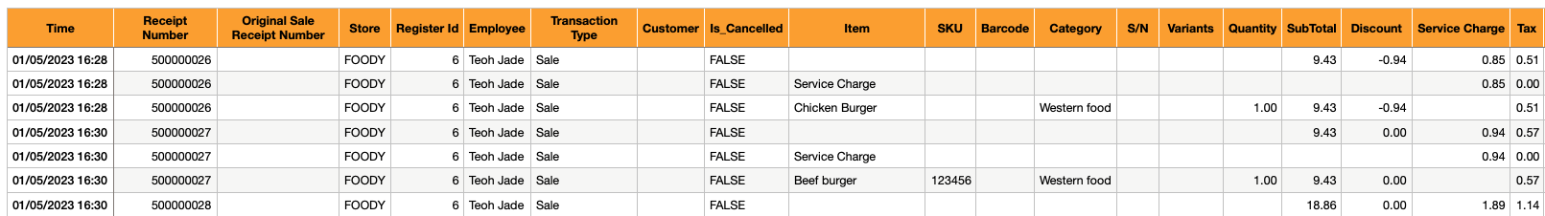
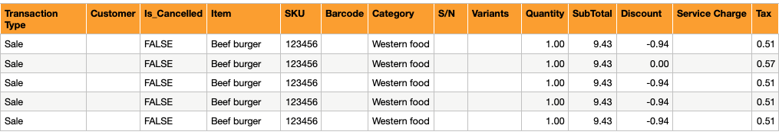
| 5. Sales Report: Overtime vs. Product Report
Reason: Itemised Sales Figure (cont.)
Filter out the item that you wish to calculate
Remove filter for “Return” items
Only sale items
Choose specific item to calculate sale

Slide 24
| 5. Sales Report: Overtime vs. Product Report
Reason: Itemised Sales Figure (cont.)
Product Report Formula:
(Sum of Item Subtotal - Sum of Item Discount) + (Sum of Item Tax - Sum of Returned Item Tax)
47.15
-3.76
2.61
On Transaction Type, filter “Return” to retrieve the sum of returned item tax
0.51
(47.15 - 3.76) + (2.61 - 0.51) = 45.49

Slide 25
Product Inventory (Composite)

Slide 26
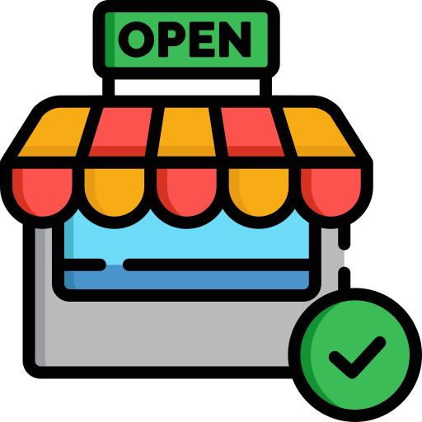
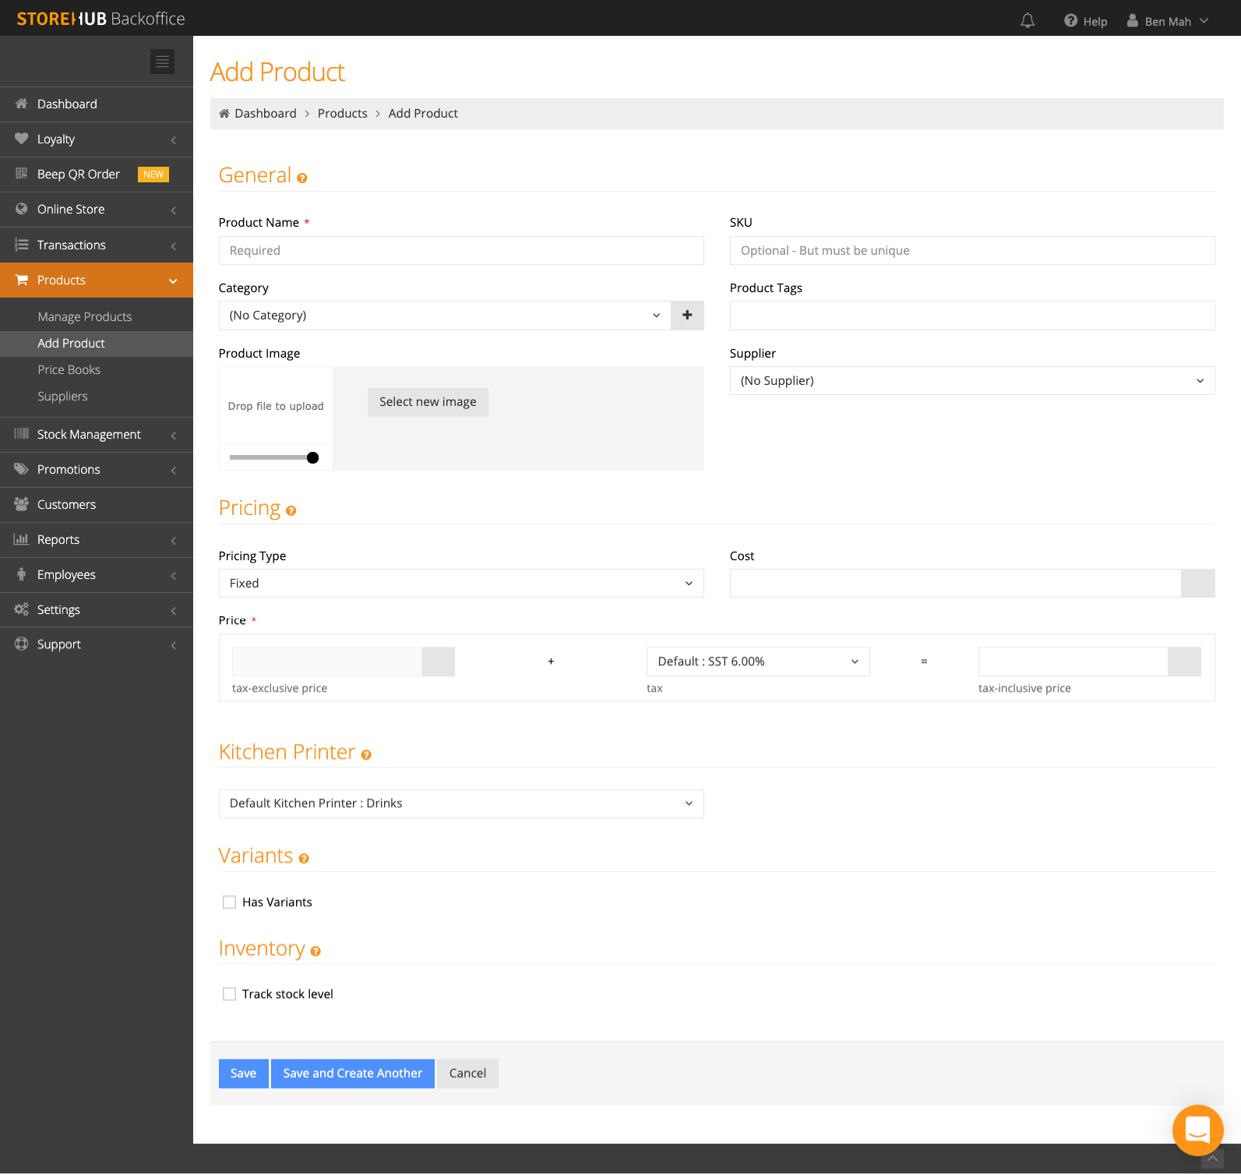
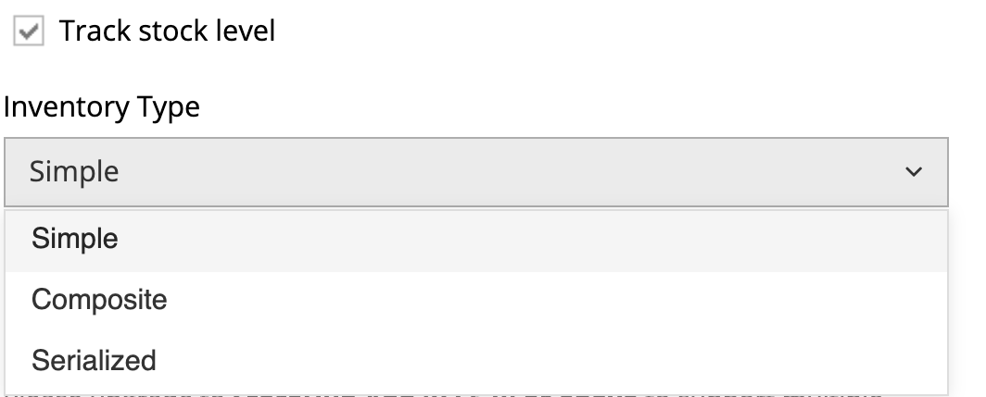
| Product Inventory
Inventory Types
1
1
Inventory
Simple
Composite
Serialized
Depending on nature of product, different type of inventory would be suitable for product
Simple
Commonly used by retail or product that has barcode
Inventory measured by whole unit
Example
A can of Cola
T-Shirt
Handbag
Composite
Reduces other product’s inventory by small units or bundled together
Complex set up
Example
Gift basket
Food ingredients
Serialized
Used by retail
Products that has serial numbers that can be tracked
Example
Phones
Television
Electronic gadgets

Slide 27
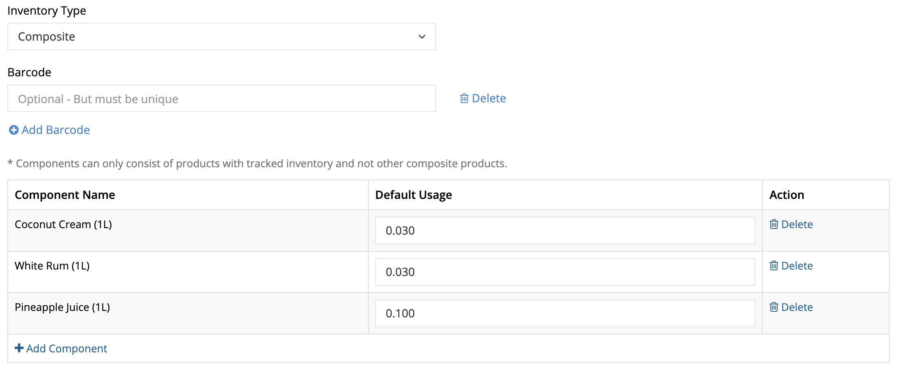
| Product Inventory
Composite Inventory
1
2
Must create a separate product that has a simple inventory. The separate products are components in the new composite inventory
Determine how much inventory should be reduced for each component sold
1
2
L = Liter

Slide 28

| Product Inventory
Examples: Composite Inventory
Example:
Main Product: Pina Colada
Ingredients: Coconut Cream, White Rum,
Pineapple juice
Amount of ingredients needed to produce a cup of Pina Colada:
Coconut Cream: 0.03L
White Rum: 0.03L
Pineapple Juice: 0.1L
Gin: 0.1L
L = Liter

Slide 29
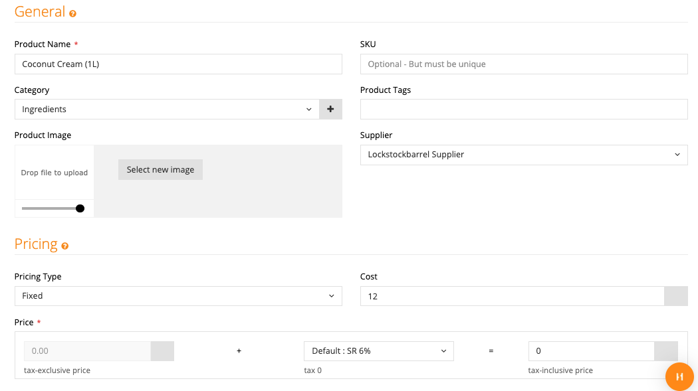
| Product Inventory
Products > Manage Products > Add Product
1
Ingredients/components of products need to be created in the BackOffice before they can be tracked under Composite Inventory
1
Ingredient Name (Product Unit)
2
Price: Set as 0 (Not selling the ingredient)
2
Optional:
SKU, Category, Product Tags, Supplier, Cost
L = Liter

Slide 30
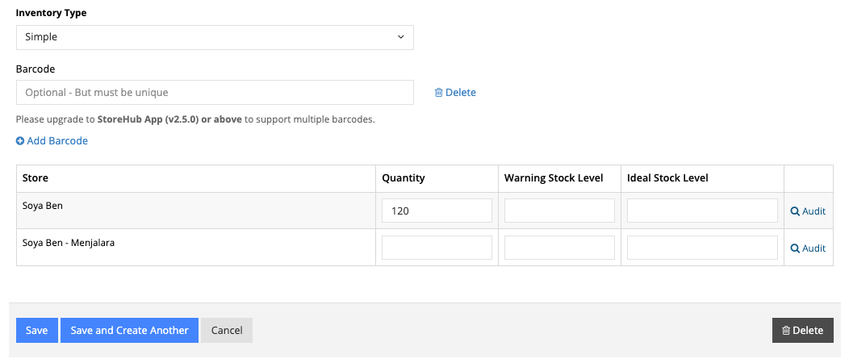
| Product Inventory
Products > Manage Products > Add Product (cont.)
3
3
Scroll down to ‘Inventory & Variants’ section, tick ‘Track Stock Level’ and select ‘Simple Inventory’
4
Key in stock quantity in store
(Based on your product unit)
Example:
Merchant bought 10 boxes of coconut cream
1 box = 12 small boxes
1 small box = 1L
Total: 10 boxes x 12 small boxes x 1L = 120L
4
5
5
Select ‘Save’ to complete the settings
Optional:
Barcode, Warning Stock Level, Ideal Stock Level
L = Liter

Slide 31
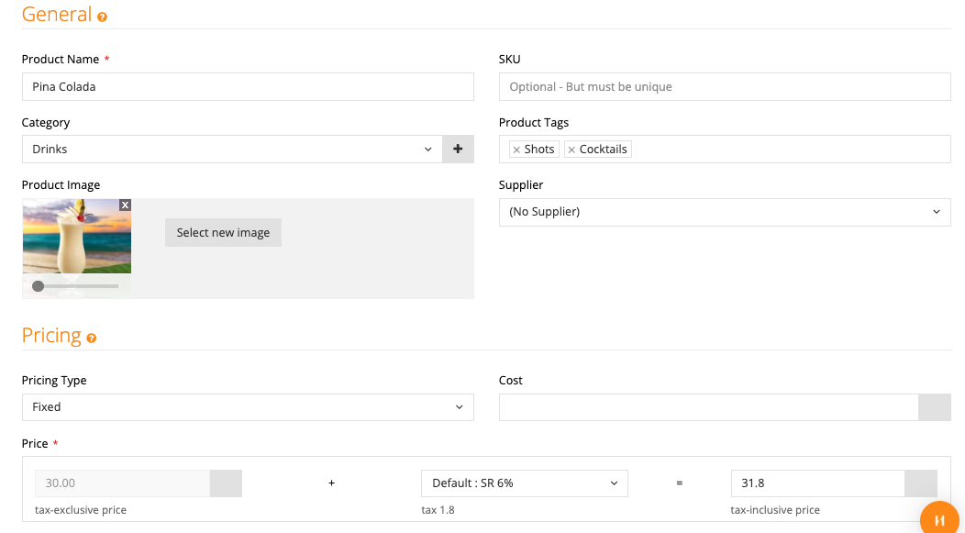
| Product Inventory
Products > Manage Products > Add Product (cont.)
6
6
Create new product for Pina Colada
7
Set the selling price
Optional:
SKU, Category, Product Tags, Supplier, Cost
7
L = Liter

Slide 32
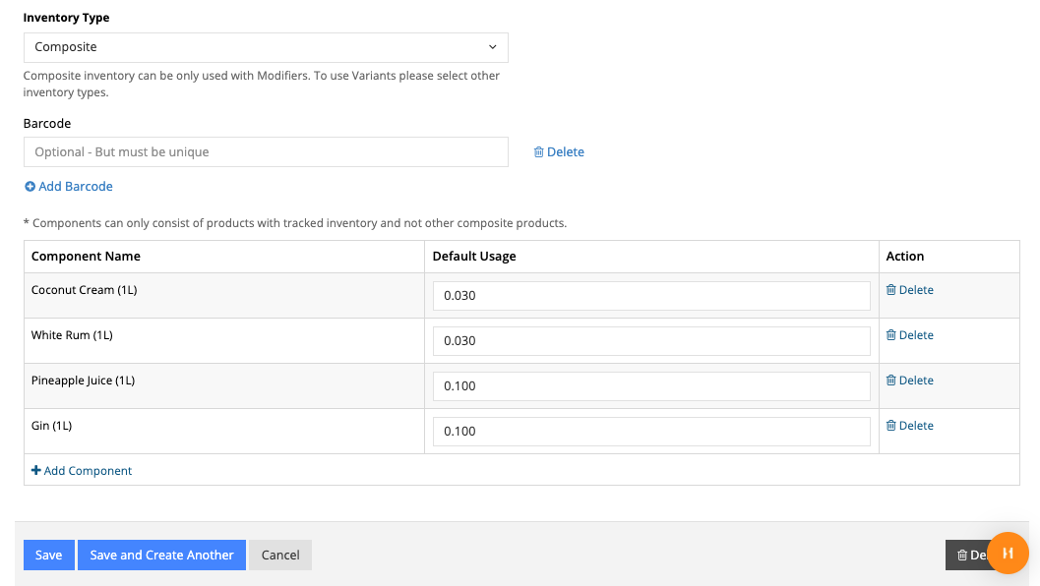
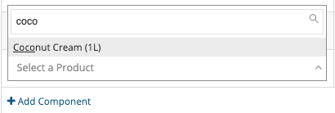
| Product Inventory
Products > Manage Products > Add Product (cont.)
8
8
Set up ‘Composite Inventory’ and hit ‘save’ to modify product. Inventory table will be refreshed
9
Click ‘Add Component’ to add your ingredients
10
10
Indicate the Default Usage (Amount of ingredient needed for the product)
Example: 0.03L of coconut cream is required to produce
a cup of Pina Colada
9
11
11
Select ‘Save’ to complete the settings
L = Liter

Slide 33
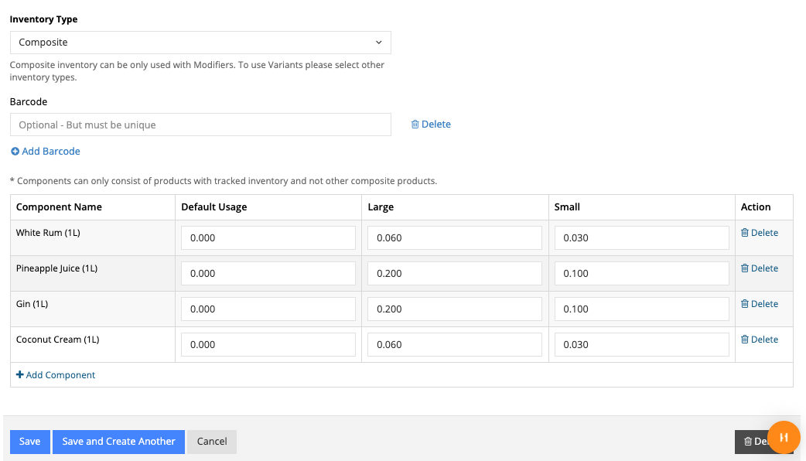
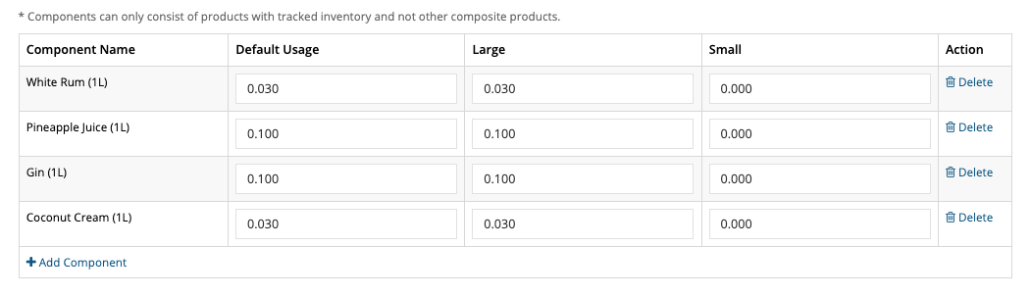
| Product Inventory
Products > Manage Products > Add Product (cont.)
Option 1
If your product has modifier, type in the desired amount of ingredients usage
Example:
The large option of Pina Colada will require double amount of each ingredient
There are 2 ways on how to setup usage:
Option 1:
> Leave ‘Default Usage’ as empty
> Key in exact amount of ingredients required for
each modifier
Option 2:
> Key in basic amount of ingredients required
under ‘Default Usage’
> Key in additional amount of ingredients required
for each modifier (On top of default usage)
Option 2
L = Liter

Slide 34
Manage Products (CSV)

Slide 35
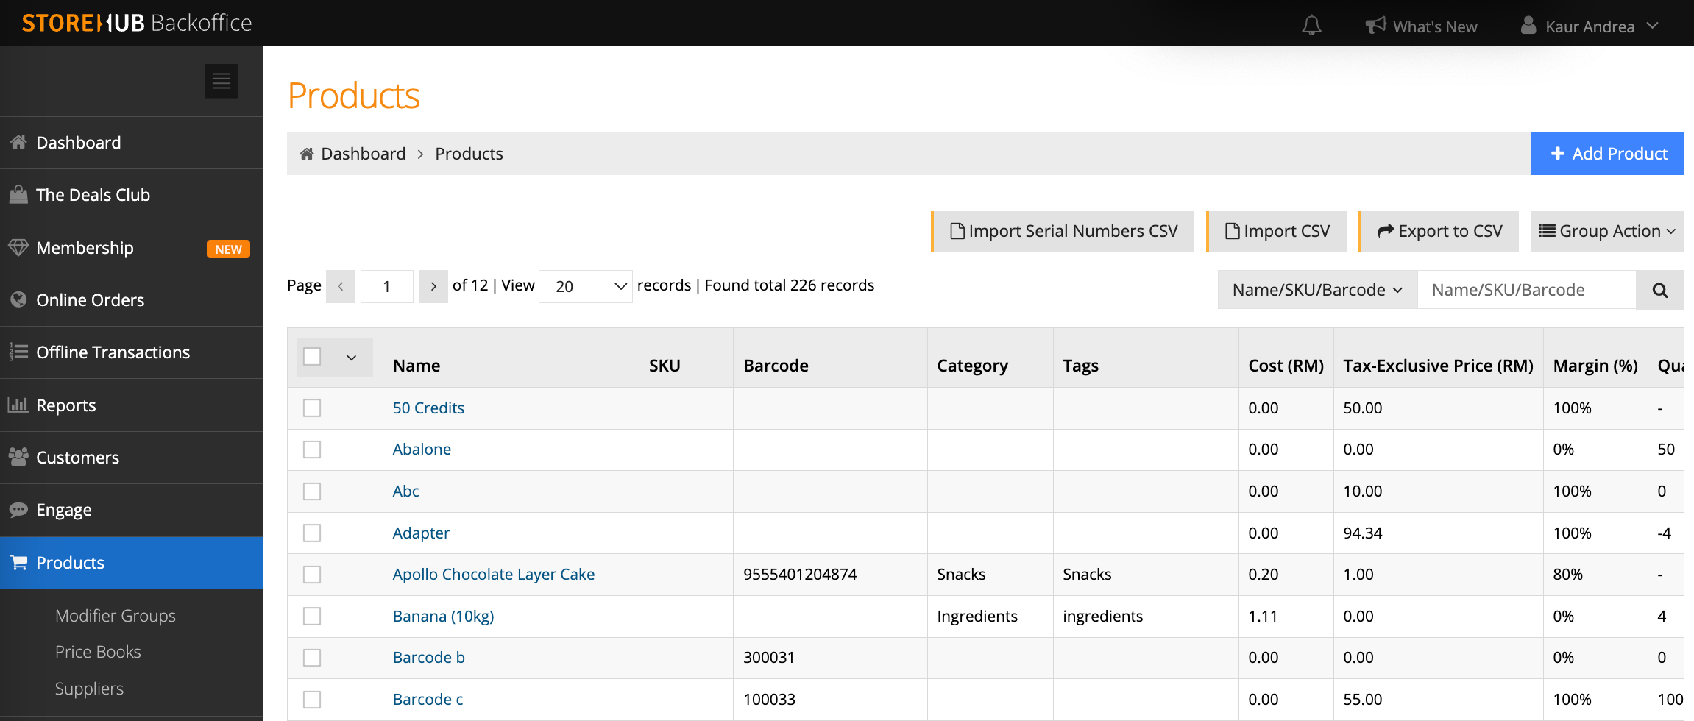
| Manage Product (CSV)
Products > Import CSV
1
Select the ‘Import CSV’ button
1
Important Note
Following features are not supported by CSV import:
Composite & Serialized Inventory
Single & Multiple Choice Modifier
Products that are not ‘Tracking Stock Level

Slide 36
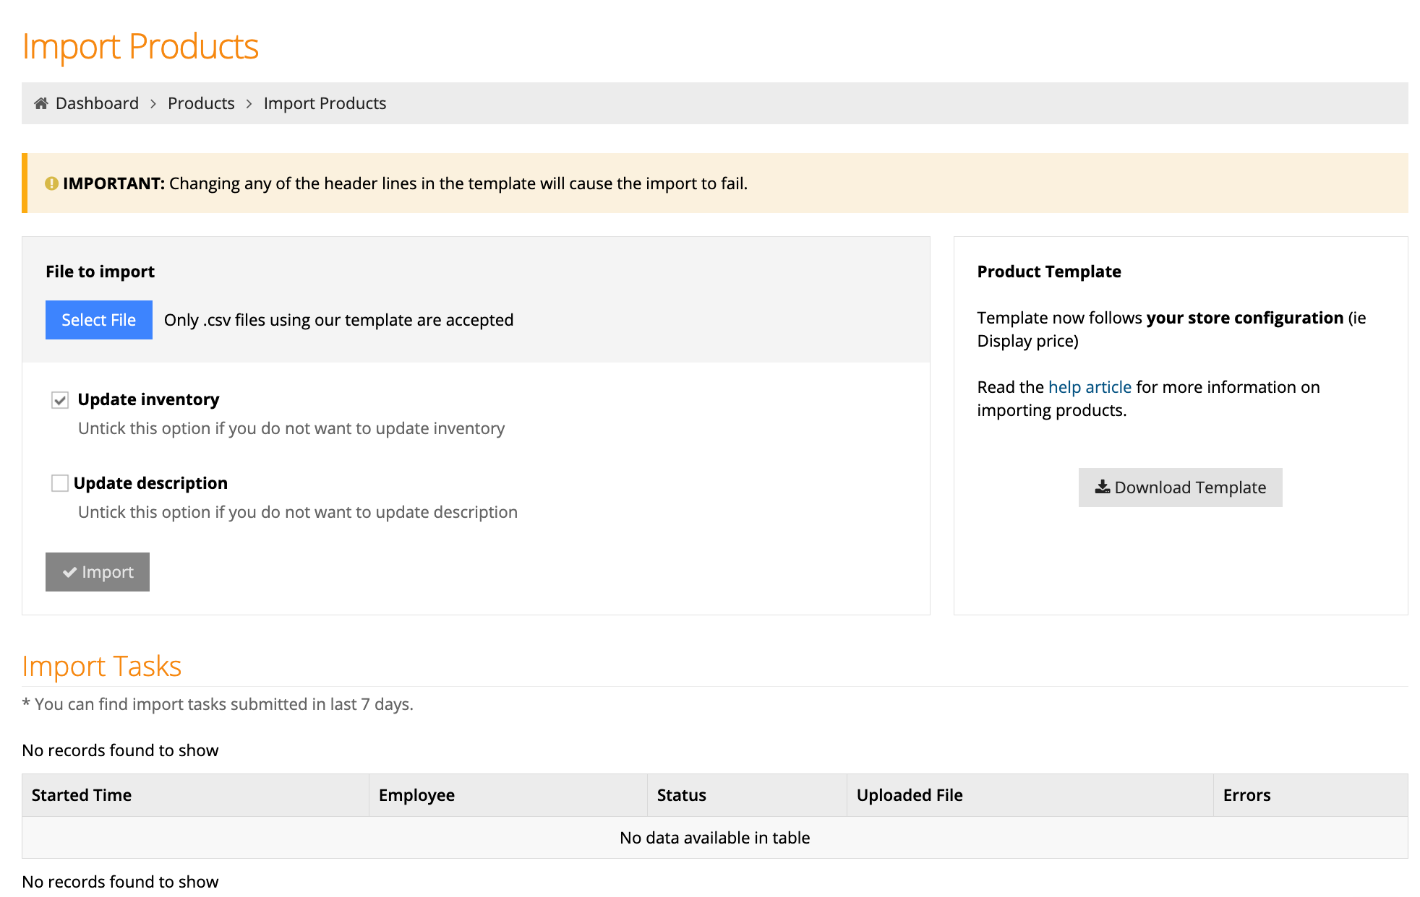
| Manage Product (CSV)
Products > Manage Products > Import CSV
2
Select ‘Download template’
2

Slide 37
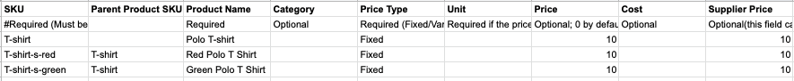
| Manage Product (CSV)
Products > Manage Products > Import CSV
1
SKU (Stock Keeping Unit)
Required (Must be unique; no space & symbols)
Product Name
Required (Do not use #, $, &. symbols)
3
2
Parent Product SKU
Optional (Use when your product has variance)
4
Category
Optional (Group of products)
1
2
3
4
5
6
7
8
9
5
Price Type
Required (Only Fixed/Variable/Unit)
Price
Optional (Exclude tax; no currency sign)
Supplier Price
Optional (Exclude tax; no currency sign)
7
9
6
Unit
Only Required if price type is Unit
Cost
Optional (Exclude tax; no currency sign)
8

Slide 38
| Manage Product (CSV)
Products > Manage Products > Import CSV
Important Note
10
Product Tags
Optional (Use Semicolon to separate tag)
12
Track Stock Levels
Required (0=No, 1=Yes)
*You may set Inventory Type as Simple/Composite/Serialized. However there’s no options to key in the components/serial numbers in CSV
11
Inventory Type*
Optional (Simple/Composite/Serialized)
13
Barcode
Optional (Must be unique)
10
11
12
13
14
15
16
14
Variant Name
Optional (Option for variant products)
15
Quantity
Optional (0 by default if tracking inventory)
Variant Value
Optional (Value of variant option)
16
Warning Stock Level
Optional

Slide 39
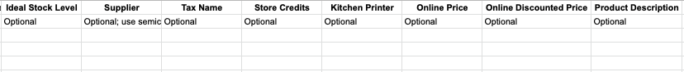
| Manage Product (CSV)
Products > Manage Products > Import CSV
17
Ideal Stock Level
Optional
19
Tax Name*
Optional
21
Online Price
Optional (Only available if online store is enabled)
18
Supplier*
Optional
20
Kitchen Printer
Optional
22
Online Discounted Price
Optional (Only available if online store is enabled)
17
18
19
20
21
22
23
Important Note
23
Product Description
Optional (Only for Online Store/Beep
*Supplier & Tax Name can be added via CSV, however supplier details & Tax code can’t be set through CSV. So it is encouraged to add Supplier/Tax Name only after supplier details & Tax has been set in BackOffice.

Slide 40
| Manage Product (CSV)
Products > Manage Products > Import CSV
Once all product information has been listed and save in your CSV template.
Go back to BackOffice > ‘Products’ > > ‘Import CSV’> ‘Select File’ to import your data.
Select ‘Import’ to complete the steps
Tick ‘Update Inventory’ & ‘Update Description’ if you wish to update those information

Slide 41
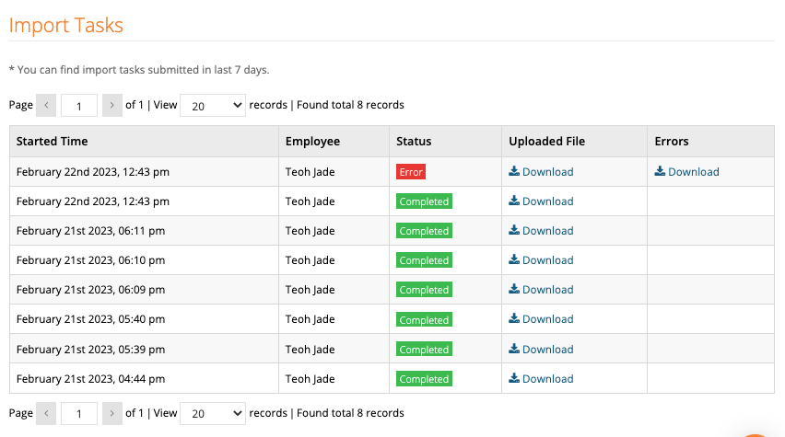
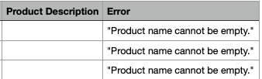
| Manage Product (CSV)
Products > Manage Products > Import CSV
Check Import Progress
Status:
Completed : Successfully uploaded
Error : Failed to upload
Download the file under ‘Errors’ column to check the errors (Last column in the CSV file)

Slide 42
Pricebook

Slide 43
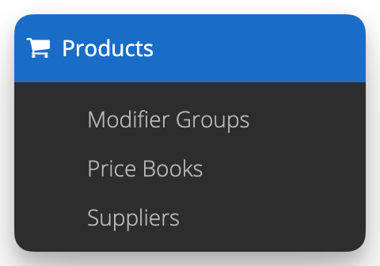
| Pricebook
Price Book
Feature that enables merchants to sell identical items:
At different prices across different stores & quantity purchased
To different customer group
Important Notes
It’s compulsory to ensure Product pricing, Pricebook & Promotion do not overlap one another. Prevent having the same setup or criteria
Pricebook is only valid for offline transactions (POS)

Slide 44


| Pricebook
Create New Price Book
1
1
Select “New Price Book’ Create a new Price Book
2
3
2
Enter a name for Price Book
3
Select the store for the Price Book
4
4
Setup Service charge settings
5
Save
5

Slide 45

| Pricebook
Create New Price Book (Cont.)
3
1
1
Select “Add item” and search for a product
2
If you wish to import products in bulk, download Default Price Book CSV file and use as template
Once you filled up all the information on CSV file & saved, select “Import Items by CSV” to import the file
3
Important Notes
Tax can only be added via CSV if it has already been set up in BackOffice.
2

Slide 46

| Pricebook
Create New Price Book (Cont.)
Once product is added:
Current product price & tax will auto reflect; Set your desired product price & tax
1
1
2
3
Set the Min/Max Qty to restrict the number of items a customer can buy, or require a minimum amount purchased
2
3
Select “Save” to complete the settings

Slide 47
| Pricebook
Create New Price Book (Cont.)
1
Edit target customer on “Apply to Customer with Tags” to offer special rates to certain customers only
1
Learn more on how to add customer tags: Here

Slide 48
Promotion

Slide 49

| Promotion
Promotion
Feature that enables merchants to configure promotion:
Based on different promotion types
To different customer group
To different channels
Applicable to certain period only
Important Note
It’s compulsory to ensure Product pricing, Pricebook & Promotion do not overlap one another; have the same setup or criteria

Slide 50


| Promotion
Promotion
1
Select “+ New Promotion”
2
Enter Promotion Name
3
Select Store to apply promotion
4
Apply to which channel Online Store = Webstore
Beep Delivery & Pick up = Beep Delivery
Beep Takeaway & Dine in = QR Order and Pay
5
Key in Promo Code for promotion (Only applicable for Online Store & Beep)
6
Toggle on to enable promotion

Slide 51

| Promotion
Promotion
1
Set up Promotion period
2
Choose Discount Type
Important Notes
Take Percentage off, Take Amount Off & Free Shipping are applicable to Online Store & Beep Delivery (Delivery)

Slide 52

| Promotion
Promotion
1
Customer Eligibility (Only applicable for Promo Type 1 & 2 )
2
Usage Limits (Only applicable for Online Store & Beep)
3
Select “Save” once all settings are completed

Slide 53
Advanced Features

Slide 54
| Advanced Features
Overview
QR Order & Pay
Beep Delivery
1
2
Multiple Register Sync
7
3
Webstore
6
4
StoreHub Engage
Membership
5
Food Delivery Integration

Slide 55
QR Order & Pay

Slide 56










| QR Order & Pay
Introduction – Static QR
Customers scan unique QR code to order without touching the menu.
Fully integrated reporting from sales & inventory to customer data analytics.
Improve ordering process & Increase table turnover.
Ordering to payment all done on your mobile phone (No direct contact required)
Digital menu and contactless payment using your own unique QR code
Refer to these KB Articles to learn how to set up
QR = Quick Response

Slide 57






| QR Order and Pay
Introduction (cont.)
ORDER COMES IN
Accepted orders sent to the kitchen automatically with table and queue number
#055
TABLE SERVICE
#028
OR
PREPARE
Orders grouped by type so restaurant can easily manage and prioritise order
TAKE AWAY
Minimize errors in the kitchen and reduce human interactions around the store
QR = Quick Response

Slide 58




| QR Order and Pay
QR Order and Pay (Pay Now)
Enable Pay at Counter in BO > Online Orders > QR Order and Pay> General Tab
Apple Pay is only supported on iPhone (iOS 9 & above)

Slide 59


| QR Order and Pay
QR Order and Pay (Pay Later)
Enable Pay Later in BO > Online Orders > QR Order and Pay> General Tab

Slide 60


| QR Order and Pay
QR Order and Pay (Pay Later on POS)
QR Order and Pay (Pay Later) order on POS Table Layout
QR Order and Pay (Pay Later) order on POS Open Order page

Slide 61




| QR Order and Pay
Additional Support (cont.)
QR Order and Pay Collaterals
Dine In
Take Away
Table Sticker
Bunting
Counter Display
Display Stand
Table Sticker
Stick on the table
Bunting
Place in restaurant, directly after entering the door
Counter Display
Place on cashier counter
Display Stand
Place at the storefront
For the complete list of collaterals available, click MY

Slide 62


| QR Order and Pay
Introduction - Dynamic QR
Dynamic QR Printed, customer places order
Customer walks in
TABLE SERVICE
OR
PREPARE
Ideal for businesses looking to manage consumer time limits effectively.
It allows merchants to set a predefined time limit for customers.
If customers wish to extend their stay, they can simply make another purchase to renew the time.
TAKE AWAY
Refer to these KB Articles for more details.

Slide 63
Beep Delivery

Slide 64

| Beep Delivery
Introduction
Customers can order from Beep App & choose between Delivery & Self Pick-Up (Immediate / Pre-Order up to 5 days in advance.
Fully integrated reporting from sales & inventory to customer data analytics.
Ordering to payment all done on your mobile phone (No direct contact required)
Refer to these KB Articles to learn how to set up

Slide 65





| Beep Delivery
Introduction (Cont.)
Step 5: Rider collects the order for delivery.
OR
Step 1: Customer browses Beepit.com or uses Beep App.
Step 2: Customer makes an order & proceed for payment.
Step 3: Merchant receives order on POS Register or StoreHub Manager App, and WhatsApp Notification If any, kitchen order prints.
Step 4: Merchant prepares the food.
Step 5: Customer visits store and collects the order.

Slide 66
| Beep Delivery
StoreHub Automated Logistic Programme (SHALP)
Merchants can choose to use SHALP or Self-delivery to fulfill Beep Delivery orders.
Coverage:
Klang Valley, Penang & Johor
Operation hours:
9am - 9pm
Powered by:
Fleet (StoreHub In-house Beep riders)
Logistic partners
GoGet
Lalamove
Borzo
Pandago
Refer to this KB Delivery Arrangements | Delivery Radius & Fee for more details.

Slide 67
TRUE
Webstore

Slide 68

| Webstore
Introduction
https://merchandise.storehub.me/
Customers can order from merchant’s Webstore store using merchant’s own brand URL.
Ordering to payment all done online.
Fully integrated reporting from sales & inventory to customer data analytics.
Refer to these KB Articles for more details.

Slide 69
Membership

Slide 70



Membership
Introduction
Step 1: Customer scans and join Membership!
Step 2: Becomes a member!
Refer to these KB Articles for more details.
SMS = Short Message Service

Slide 71






Membership
Introduction
Membership
Points-based Rewards
Customers earn points with every order and exchange them for rewards
Welcome Rewards
Get your customers to sign up for your loyalty program with a discount or freebie
Discounts & Promotions
Boost returning customers with permanent or time-sensitive discounts
Cashback
Gain cashback on every order to save on the next purchase
Birthday Promos
Treat your customers to a special discount on their birthday month
Free Gifts
Give out free items when your customers achieve certain milestones
Refer to these KB Articles for more details.
SMS = Short Message Service

Slide 72

Membership
Membership Insights
Gain valuable insights about your members, such as:
Percentage of Member Transactions and Member Sales.
Average Lifetime Value of Members vs Non-Members.
Redemption rates for Rewards, Points, and Cashback.
Top 5 spenders and other detailed performance metrics
Refer to these KB Articles for more details.

Slide 73

Membership
Rewards Settings
Customize each membership tier by setting the points earned, cashback, and exclusive benefits.
As customers advance through the tiers, they can unlock greater rewards, encouraging loyalty and repeat visits merchants store.
Refer to these KB Articles for more details.
SMS = Short Message Service

Slide 74

Membership
Rewards Settings (Cont.)
Set a threshold amount for customers to reach at each tier to unlock the next level.
Set how many points customers earn per spend to redeem for future vouchers.
Set cashback rewards for each tier, offer higher amounts as customers progress.
Refer to these KB Articles for more details.
SMS = Short Message Service

Slide 75

Membership
Rewards Settings (Cont.)
Link specific promotions to each tier so customers can earn rewards based on their tier level.
Only the ‘Take Amount Off’ and ‘Take Percentage Off’ discount types are applicable for membership promotions.
Set a pricebook for specific tiers to let customers enjoy exclusive rewards and pricing.
Set tier upgrade rewards so customers receive discounts or special offers when they reach a new tier.
Refer to these KB Articles for more details.
SMS = Short Message Service

Slide 76
Food Delivery Integration

Slide 77

| Food Delivery Integration
Get Started
Merchants need to be selling through food delivery platforms
Only Applicable For ADVANCE and PRO Plans
Food delivery platforms synchronized and directly recorded in the POS, BackOffice Order Management, and Reports
Merchant don’t need to manually enter each order into the POS
Merchant Success Manager will handle manual charges to merchants
POS = Point Of Sales

Slide 78
| Food Delivery Integration
Get Started (cont.)
Enable Food Delivery Add On
Enter Store Detail and Tax Rate
Toggle On “Connect”
03
02
04
01
05
Step up Store Menu and Collections
Click On “Go Live” Button

Slide 79

| Food Delivery Integration
Settings: Create New Product
Input selling Price > Click Save
Important :
Tax rate must correspond to the default tax rate set by the merchant in BackOffice and tax rate set on the merchant's food delivery platform to ensure accurate tax calculation

Slide 80
| Food Delivery Integration
Settings: Product Setup For Food Delivery Platform Menu
To Update | How to update
FoodPanda / ShopeeFood Product Price | CSV upload/Product page
Product Description | CSV upload/Product page
FoodPanda / ShopeeFood Variant Add-on Price | Product Page
Product Images | Product Page
Important Note:
One-way sync from BackOffice to the food delivery platform, merchants need to update this information in the BackOffice to match what they have in the food delivery platforms

Slide 81

| Food Delivery Integration
Settings: Mark Out–of-Stock
Look for the item to mark as out-of-stock, then toggle it off
Click on Settings > Beep Menu
Products have to be marked Sell on Beep in order to toggle Out of Stock from the POS / StoreHub Manager

Slide 82

| Food Delivery Integration
Settings: Mark Out–of-Stock (cont.)
Once toggled off, there will be two options, select one:
Today
Item will be out-of-stock only for the day it’s toggled off (automatically be back-in-stock-toggled on the next day)
Until Restocked
Item will remain out-of-stock until it is manually toggled on
This feature is applicable for FoodPanda and ShopeeFood

Slide 83




| Food Delivery Integration
Go Live: Add Store
Ensure that the Add-Ons (foodpanda / ShopeeFood) are enabled & click “Add Store”
Select the store name and other required information
After completion, click "Connect” to confirm

Slide 84


| Food Delivery Integration
Go Live: Status
Status will display as "Pending” activation could take up to two business days
Once activated, status will change to "Connected"

Slide 85


| Food Delivery Integration
Go Live: Sync Menu
Must "Sync Menu" prior to going live, process can take up to 5 minutes

Slide 86



| Food Delivery Integration
Handle Orders: Foodpanda & ShopeeFood
Step 1 : Customer places order
Step 2 : Driver assigned to order
Step 3: Merchants must click "accept" on Foodpanda/ ShopeeFood tablet to accept order
Step 4 :Foodpanda/ ShopeeFood tablet generates a receipt
Step 5 :POS terminal will receive an order-specific notification at the same time
POS = Point of Sales

Slide 87


| Food Delivery Integration
Handle Orders: Receipt
1
2
Kitchen docket >> Print orders
Foodpanda - ‘FP’-<order number> ShopeeFood - ‘SF’-<order number>
Receipt printed from Foodpanda/ ShopeeFood tablet
2
1
Important Note
Receipt will not be printed from StoreHub POS. Merchant can manually print it out by navigating to the Transaction page on the POS.

Slide 88

| Food Delivery Integration
Handle Orders – Foodpanda & ShopeeFood (cont.)
Merchants can examine orders displayed on the POS System
Order status and past order status are also viewable on the POS System
Refer to this document for more information on FDI Onboarding Process Flow

Slide 89
StoreHub Engage

Slide 90


| Campaign Types
What is StoreHub Engage?
This feature can be found in BackOffice
Once activated, it allows you to utilize customer data to target specific customers with enticing loyalty program through Automated SMS
Important Notes:
Can be used to attract existing customers throughout different stages of sales cycle
For incentivizing customer spending
Prior to this, the only forms of customer engagement programs available were Cashback, Store credits, Promo Codes, and Gift Vouchers
Refer to these KB Articles for more details.

Slide 91





| Campaign Types
Types of Campaigns you can set up
1. Welcome New Customers
> Offer new customers on promos to entice them to return
4
4. Win back lost customers
> Offer rewards to inactive customers to return
1
2. Birthday Promotions
> Cheerful wish and a promo code will be given to customers
5. Boost Google Reviews
> Remind customers to leave reviews
2
5
3. Cashback Reminder
> Remind customers to redeem their existing cashback
3
6. Custom Campaign
> Send any seasons greetings & special promos to selected customers.
6

Slide 92




| Campaign Types
SMS Templates
SMS Templates
Merchants will have the option write messages to their customers depending on the nature
You can customize the SMS Content at the BackOffice : Engage > Campaign Setup > Edit > SMS Content
Language options (English/Malay) is only applicable for < Expiring Cashback Alert & Cashback Reminder>

Slide 93

| Campaign Types
SMS Top Up
How to Top Up SMS credit
1. BO > Billing > SMS
2. Purchase in bulk to get discounts
2
3. Or manual top up for specific amounts (minimum top-up amount is 500 credits)
Important Note: Need a credit card saved in your SH account to process the top-up
3
1
BO = Back Office | SMS = Short Message Service | SH = StoreHub

Slide 94


| Activation
Activating StoreHub Engage (cont.)
How to Set Up Campaign
Fill in required information at:
Brand Name : Business name
1
2. SMS Content: Customized message
3. Attributes: Automatically insert values such as a customer’s first name or remaining cashback amount, into this SMS content
2
4
4. Target Customers: Customers’ info
(amount of cashback balance, last
purchase date & days before birth date to
send SMS)

Slide 95

| Activation
Activating StoreHub Engage (cont.)
How to Set Up Campaign
5
Fill in required information at:
5. Schedule: Set the campaign date (only future dates can be chosen; present & past dates are blocked) and the time of SMS sent daily. Once set, click save & next.
6
6. Review the information on campaign estimation & you can click on publish.
Note: Cost estimations only appear for:
“Cashback reminder”
“Win back lost customers”

Slide 96
Multiple Register Sync
Not applicable for Onboarding Executive, skip to next topic

Slide 97


| Multiple Register Sync
Overview
Multiple Register Sync
Any ordering register can now take orders and process checkouts, including cancellations and refunds.
Orders from all registers (Cashier or Ordering) are synced in real-time across all devices.
No restriction on which device can checkout – all registers have full checkout capability.
Cashier Register
Ordering Register
Ordering Register
Refer to these KB Articles for more details.

Slide 98
| Multiple Register Sync
Requirements
Network Requirements
Hardware Requirements
Type of Connection | LAN (For Android) & WiFi (iPad)
Latency | 50ms or lower
Bandwidth Capacity | 30-50 Mbps
Note | Always recommend Merchants to connect to StoreHub router.
iPad | iOS 11 or higher Note: it is advisable to use iPads of the same model (iPad Gen 6 or higher)
Android | Sunmi T2 (Android 7) iMin D4 (Android 11) iMin D1, D3, D3 mini (Android 11) iMin Falcon 1 & 2 (Android 11)
Note | iPad can be synced with StoreHub Android device & vice versa.
Important Note
Maximum 5 ordering registers can be setup

Slide 99

| Multiple Register Sync
Enable Multiple Register Sync in BO
Step 1:
Go to "Settings" > "Account" > "F&B" tab.
"tick" the checkbox for "Multiple POS Registers Sync".
Step 2:
You have the option to allow only the Cashier Register (Local Server) to process checkouts, or to include your Ordering Registers (Client Registers) as well.
Step 3:
Click "Save"

Slide 100


| Multiple Register Sync
Enable Multiple Register Sync on POS
Step 1:
On the Cashier Register, tap the menu and select “Settings”
Step 2:
In the “Multiple Register Sync” page, toggle ON “Set This Register As Local Server”.
Note: Only Cashier Register can perform checkouts; Ordering POS only take orders

Slide 101

| Multiple Register Sync
Connecting Ordering Registers (Client)
Step 1:
On the Ordering Registers, ensure they are connected to the same WiFi Network as the Cashier Register.
Step 2:
In StoreHub POS App, tap settings , select Multiple Register Sync.
Check to see if your ordering register has connected to the Cashier Register.

Slide 102


| Multiple Register Sync
Ordering on Ordering Register
Step 1:
On the Ordering Register, tap “Save” after selecting items
Step 2:
Input Order Number then tap “Save”.

Slide 103


| Multiple Register Sync
View Saved Orders
Step 1:
On the Cashier Register or other Ordering POS, tap “Orders”
Step 2:
View all open orders in this page > tap to view orders or to checkout

Slide 104

CULTIVATE
THIS DOCUMENT IS STRICTLY PRIVATE AND CONFIDENTIAL. THIS IS INTENDED FOR INTERNAL USE ONLY; DO NOT CIRCULATE
Copyright © 2022 Storehub. All rights reserved. No parts of this document can be reproduced, distributed, transmitted or stored electronically without Storehub’s prior written permission.

